Slide 1
Robust Device-Independent Quantum Key Distribution
Rene Schwonnek, Koon Tong Goh, Ignatius W. Primaatmaja, Ernest Y.-Z. Tan, Ramona Wolf, Valerio Scarani, Charles C.-W. Lim

Slide 2
Overview
Device-independent QKD (DIQKD) intro
Approach for improved robustness
Computing key rate
Results
Implications for Bell experiments
Next steps
Generalizations

Slide 3
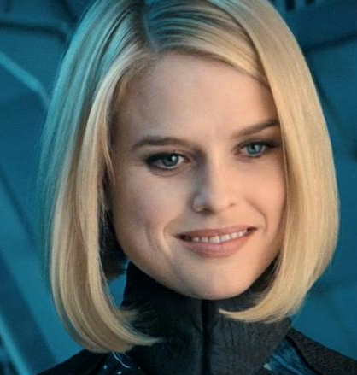
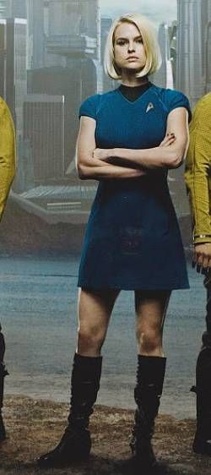

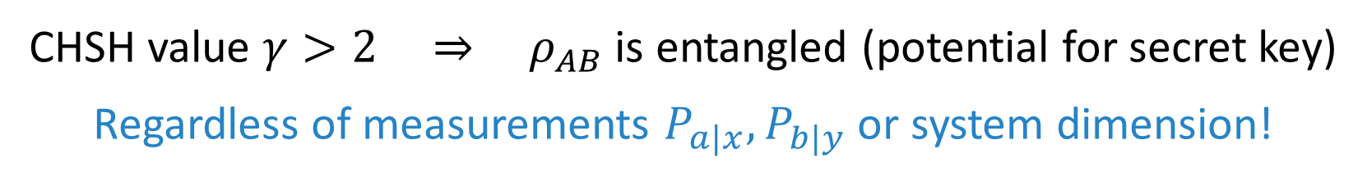
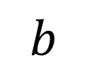
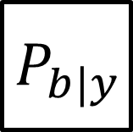
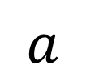
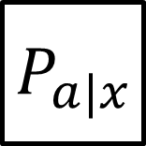
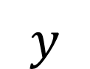

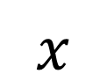
Device-independent scenario
$$x$$
$$y$$
$$P_{a|x}$$
$$P_{b|y}$$
$$ρ_{ABE}$$
$$a$$
$$b$$
CHSH value $γ>2$ ⇒ $ρ_{AB}$ is entangled (potential for secret key)
Regardless of measurements $P_{a|x},P_{b|y}$ or system dimension!

Slide 4
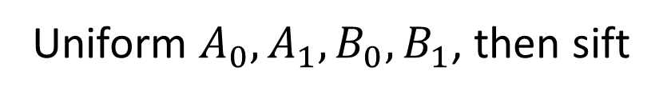
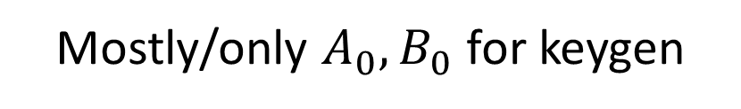
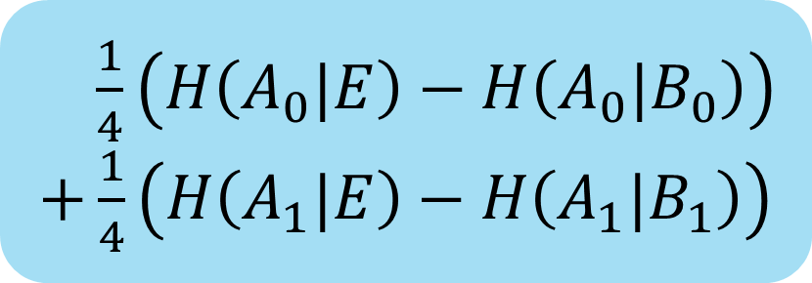
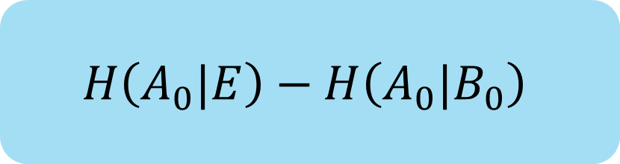
DIQKD key rate: one-way, CHSH
Mostly/only $A_{0},B_{0}$ for keygen
$$H\left(A_{0}|E\right)−H\left(A_{0}|B_{0}\right)$$
Originally (Devetak-Winter) for IID, recently extended to coherent attacks [AFRV16]
“Standard protocol”
Uniform $A_{0},A_{1},B_{0},B_{1}$, then sift
$\frac{1}{4}\left(H\left(A_{0}|E\right)−H\left(A_{0}|B_{0}\right)\right)$
$+\frac{1}{4}\left(H\left(A_{1}|E\right)−H\left(A_{1}|B_{1}\right)\right)$
Also studied more general distributions (we find uniform seems optimal)
“Uniform-basis-choice protocol”

Slide 5
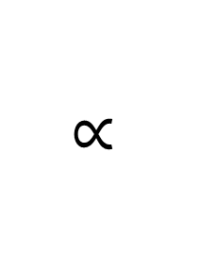

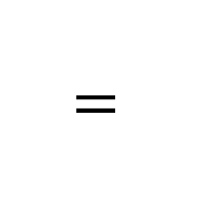
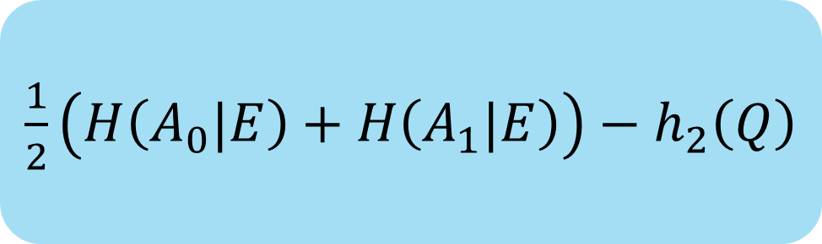
DIQKD key rate: is it positive?
Mostly/only $A_{0},B_{0}$ for keygen
$$H\left(A_{0}|E\right)−H\left(A_{0}|B_{0}\right)$$
$$=$$
$$H\left(A_{0}|E\right)−h_{2}\left(Q\right)$$
(Depolarizing noise)
Uniform $A_{0},A_{1},B_{0},B_{1}$, then sift
$\frac{1}{4}\left(H\left(A_{0}|E\right)−H\left(A_{0}|B_{0}\right)\right)$
$+\frac{1}{4}\left(H\left(A_{1}|E\right)−H\left(A_{1}|B_{1}\right)\right)$
$$∝$$
$\frac{1}{2}\left(H\left(A_{0}|E\right)+H\left(A_{1}|E\right)\right)−h_{2}\left(Q\right)$

Slide 6
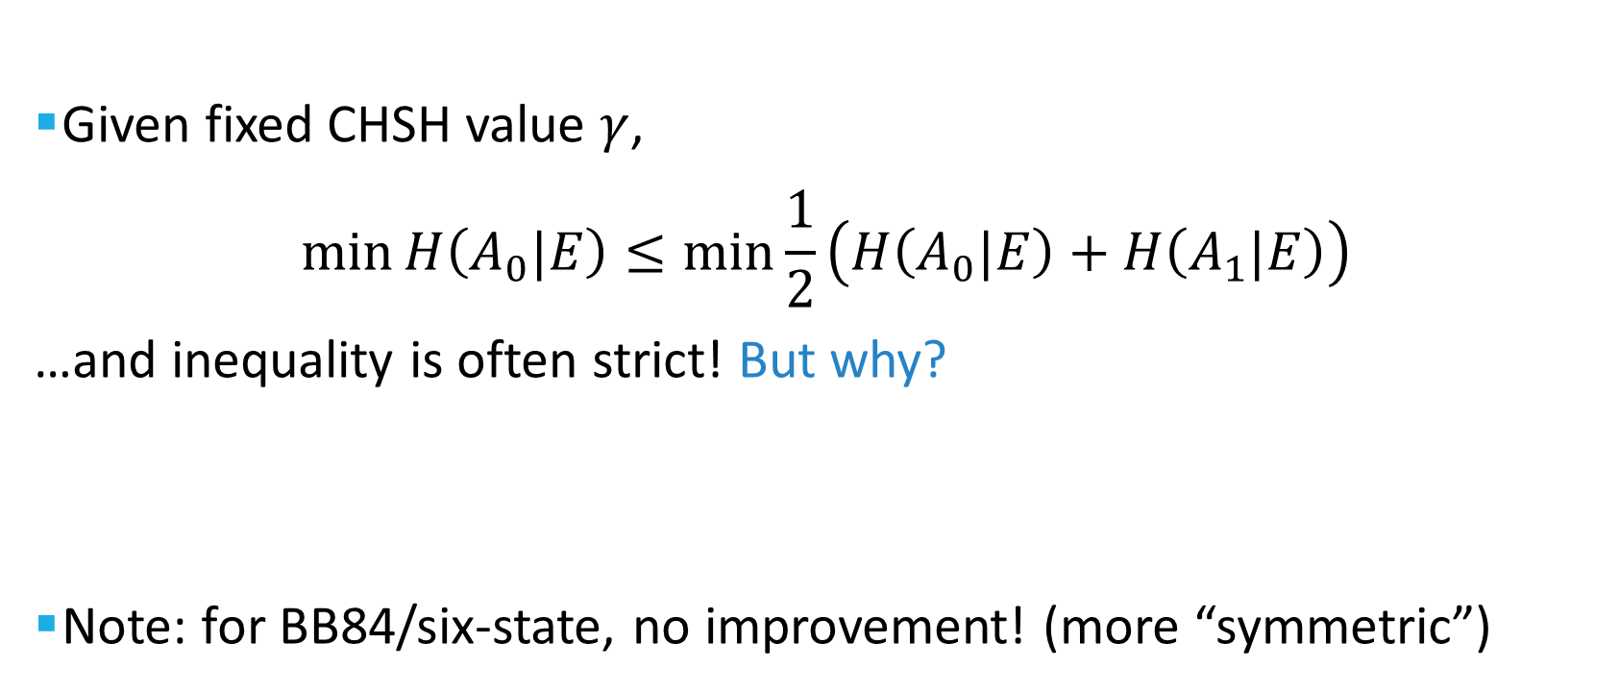
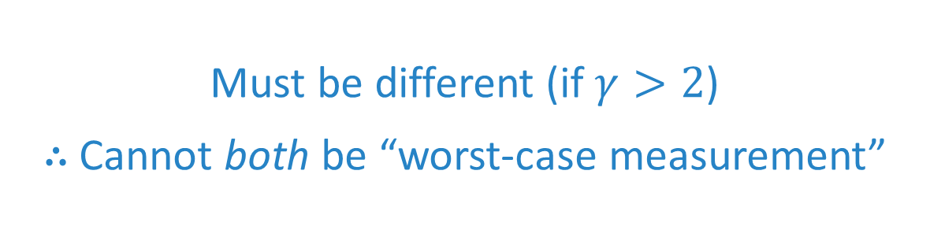
Key observation
Given fixed CHSH value $γ$,
$$\min_{}{H\left(A_{0}|E\right)}≤\min_{}{\frac{1}{2}\left(H\left(A_{0}|E\right)+H\left(A_{1}|E\right)\right)}$$
…and inequality is often strict! But why?
Note: for BB84/six-state, no improvement! (more “symmetric”)
“Worst-case measurement”
Must be different (if $γ>2$)
∴ Cannot both be “worst-case measurement”

Slide 7

Main optimization
$$\min_{P_{a|x}, P_{b|y}, ρ}{ \frac{1}{2}\left(H\left(A_{0}|E\right)+H\left(A_{1}|E\right)\right)}$$
$$such that \left\langle CHSH\right\rangle =γ$$
2-input 2-output: “Jordan’s lemma”
⇒ sufficient to consider (mixtures of) qubit states

Slide 8
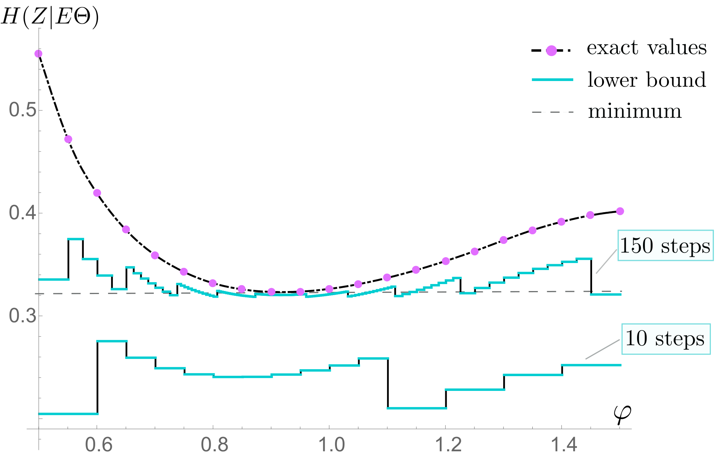

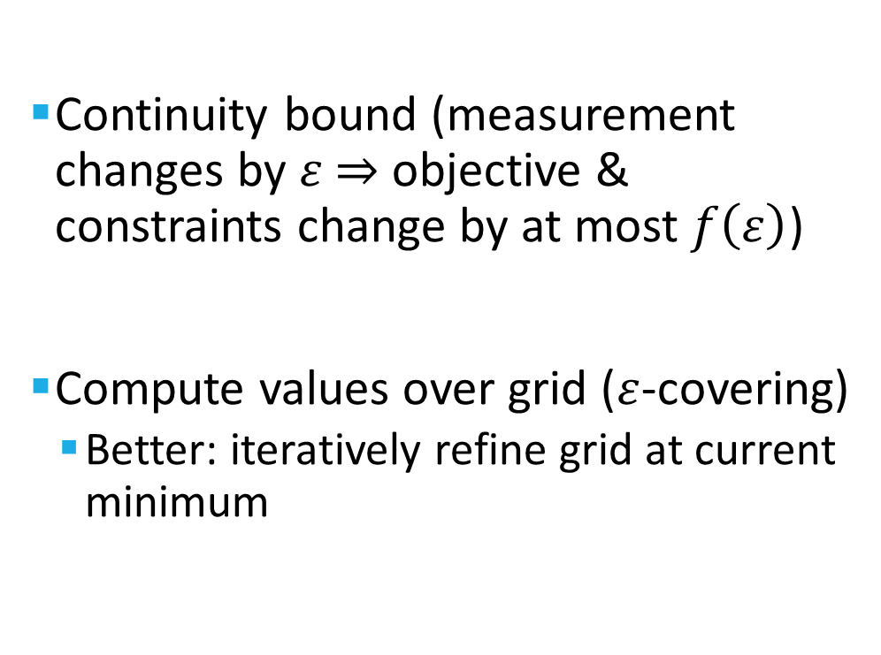
Optimization over $P_{a|x}$
Continuity bound (measurement changes by $ε$ ⇒ objective & constraints change by at most $f\left(ε\right)$)
Compute values over grid ($ε$-covering)
Better: iteratively refine grid at current minimum

Slide 9

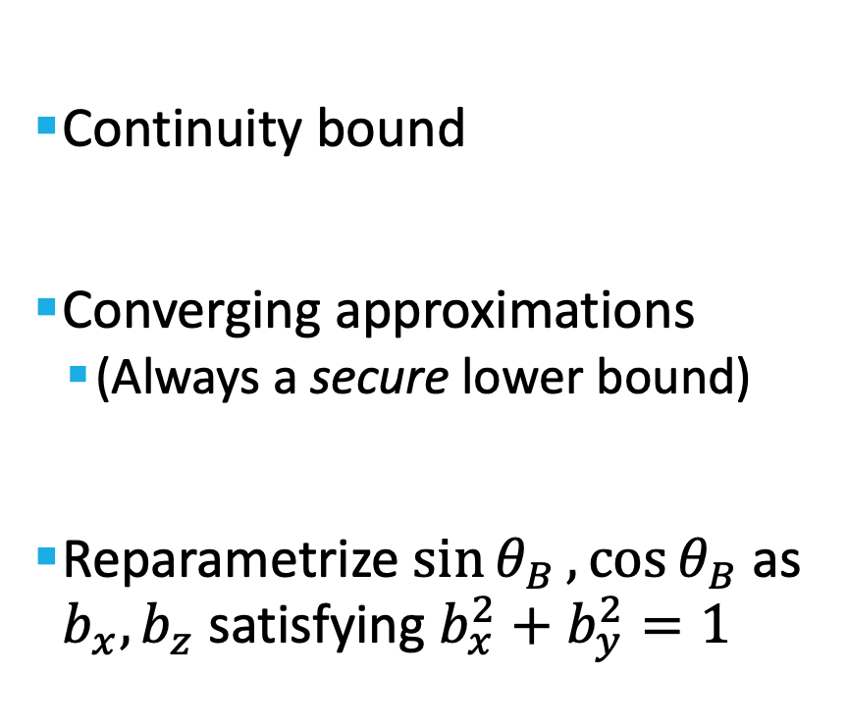
Optimization over $P_{b|y}$
Continuity bound
Converging approximations
(Always a secure lower bound)
Reparametrize $\sin{θ_{B}},\cos{θ_{B}}$as $b_{x},b_{z}$ satisfying $b_{x}^{2}+b_{y}^{2}=1$
(Used in e.g. [SDW17] arxiv:1705.10679)

Slide 10
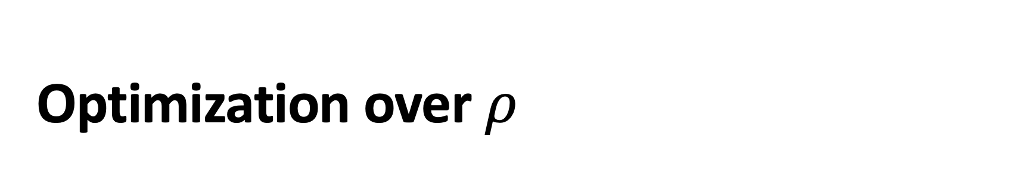
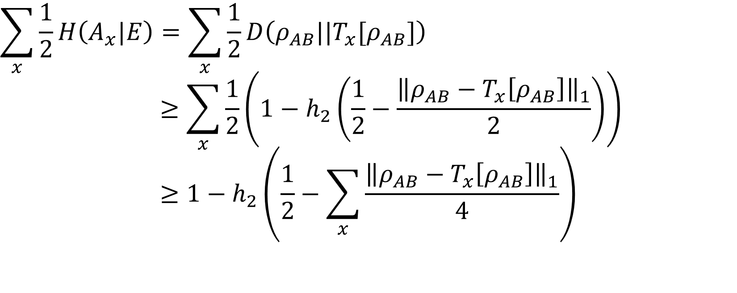
Optimization over $ρ$
$$\sum_{x}{\frac{1}{2}H\left(A_{x}|E\right)}=\sum_{x}{\frac{1}{2}D\left(ρ_{AB}||T_{x}[ρ_{AB}]\right)}$$
$$≥\sum_{x}{\frac{1}{2}\left(1−h_{2}\left(\frac{1}{2}−\frac{{\left\|ρ_{AB}−T_{x}\left[ρ_{AB}\right]\right\|}_{1}}{2}\right)\right)}$$
$$≥1−h_{2}\left(\frac{1}{2}−\sum_{x}{\frac{{\left\|ρ_{AB}−T_{x}\left[ρ_{AB}\right]\right\|}_{1}}{4}}\right)$$
see e.g. [Col11] arXiv:1110.1664
New Pinsker-type inequality
Convexity
Bound using SDP

Slide 11
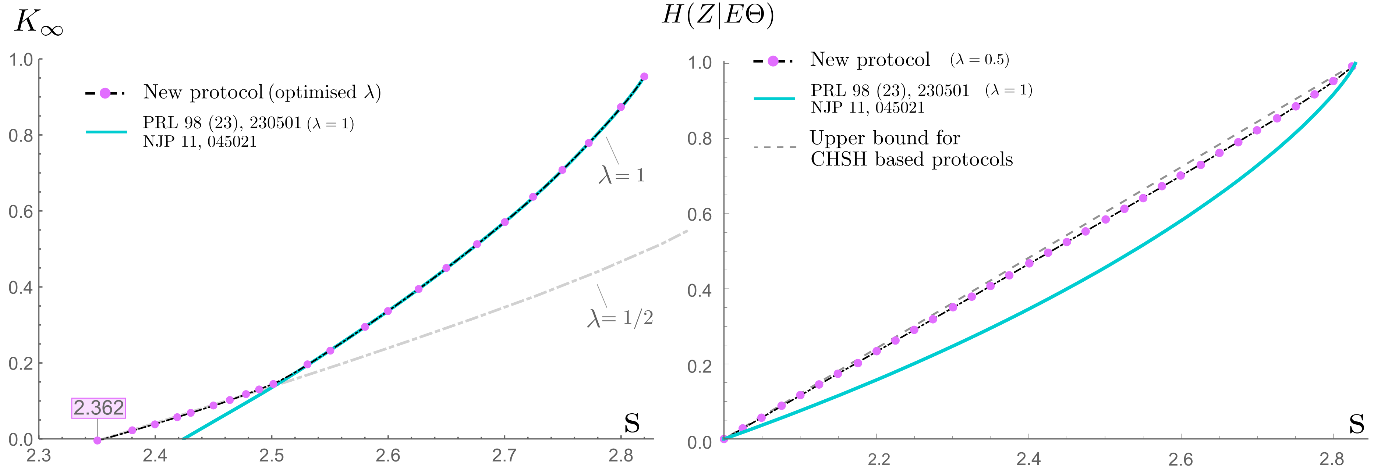
Results (depolarizing noise)
Key rate
$H\left(A_{X}|E\right)$ (averaged over input $X$)
Our results
[PAB+09] arXiv:0903.4460
Best possible bound
(by convexity)
Our results
[PAB+09] arXiv:0903.4460
QBER = 8.24%
CHSH = 2.36
QBER = 7.16%
CHSH = 2.42
CHSH
CHSH

Slide 12
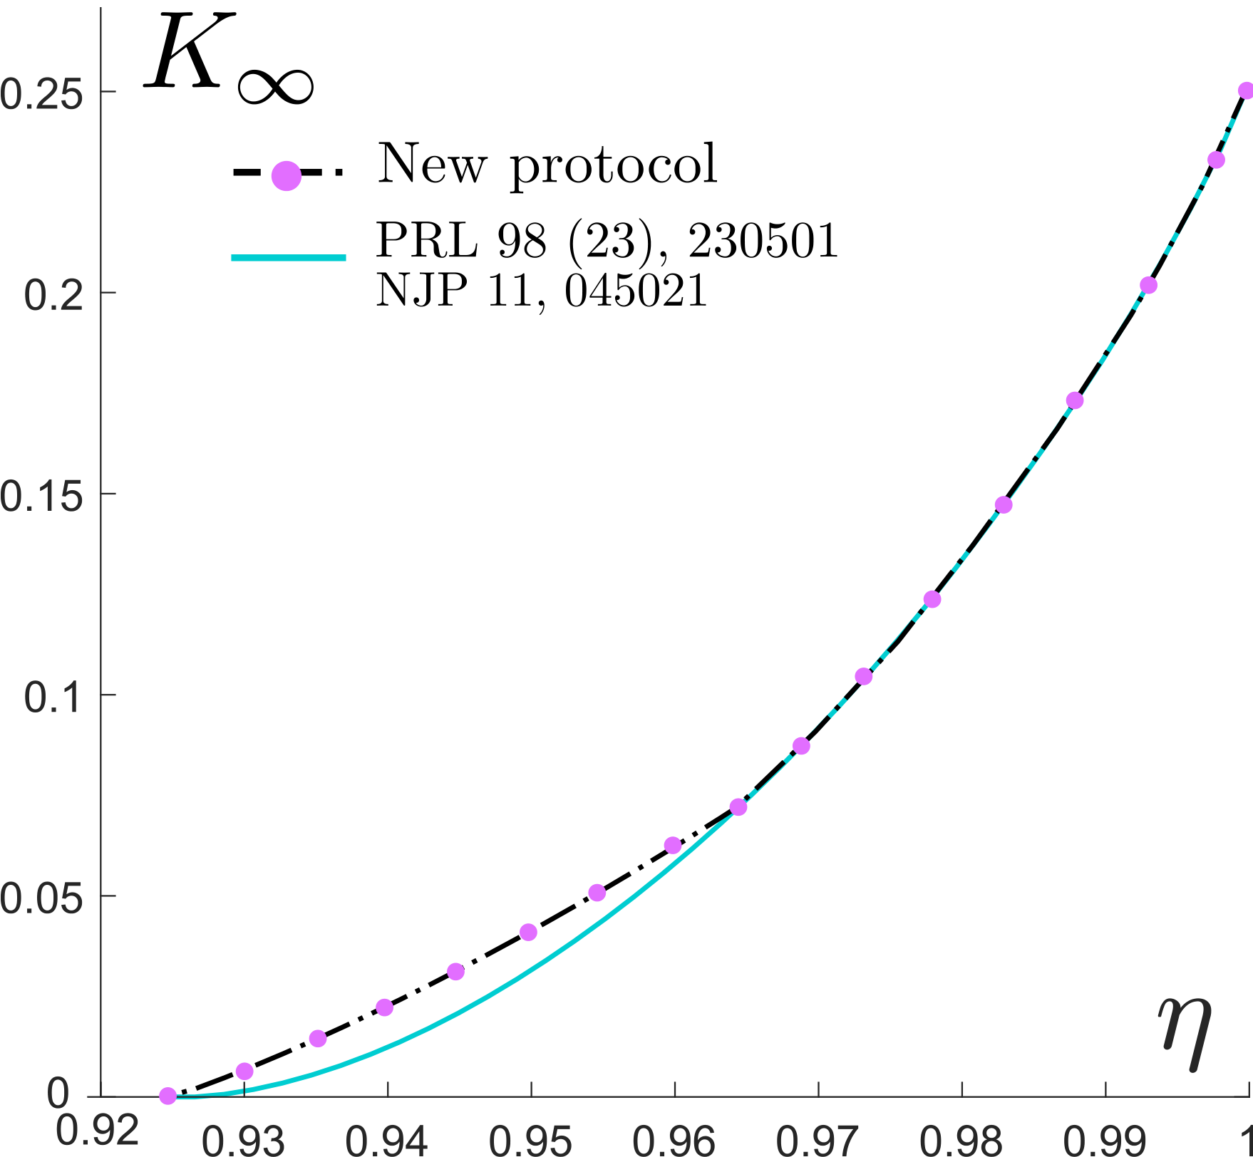
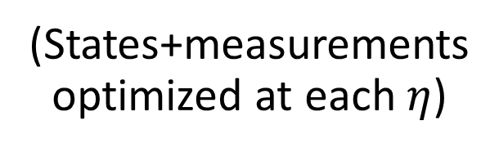

Results (photonic model)
Keyrate
(States+measurements optimized at each $η$)
Our results
[PAB+09]
$\frac{1}{4}\left(H\left(A_{0}|E\right)−H\left(A_{0}|B_{0}\right)\right)$
$+\frac{1}{4}\left(H\left(A_{1}|E\right)−H\left(A_{1}|B_{1}\right)\right)$
Hard to make both small

Slide 13
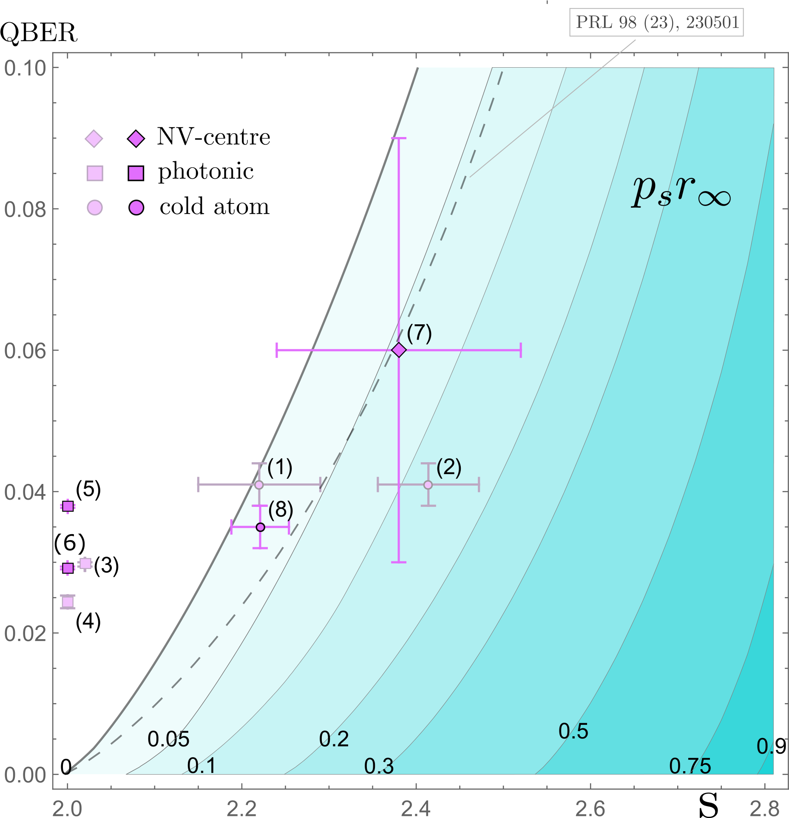
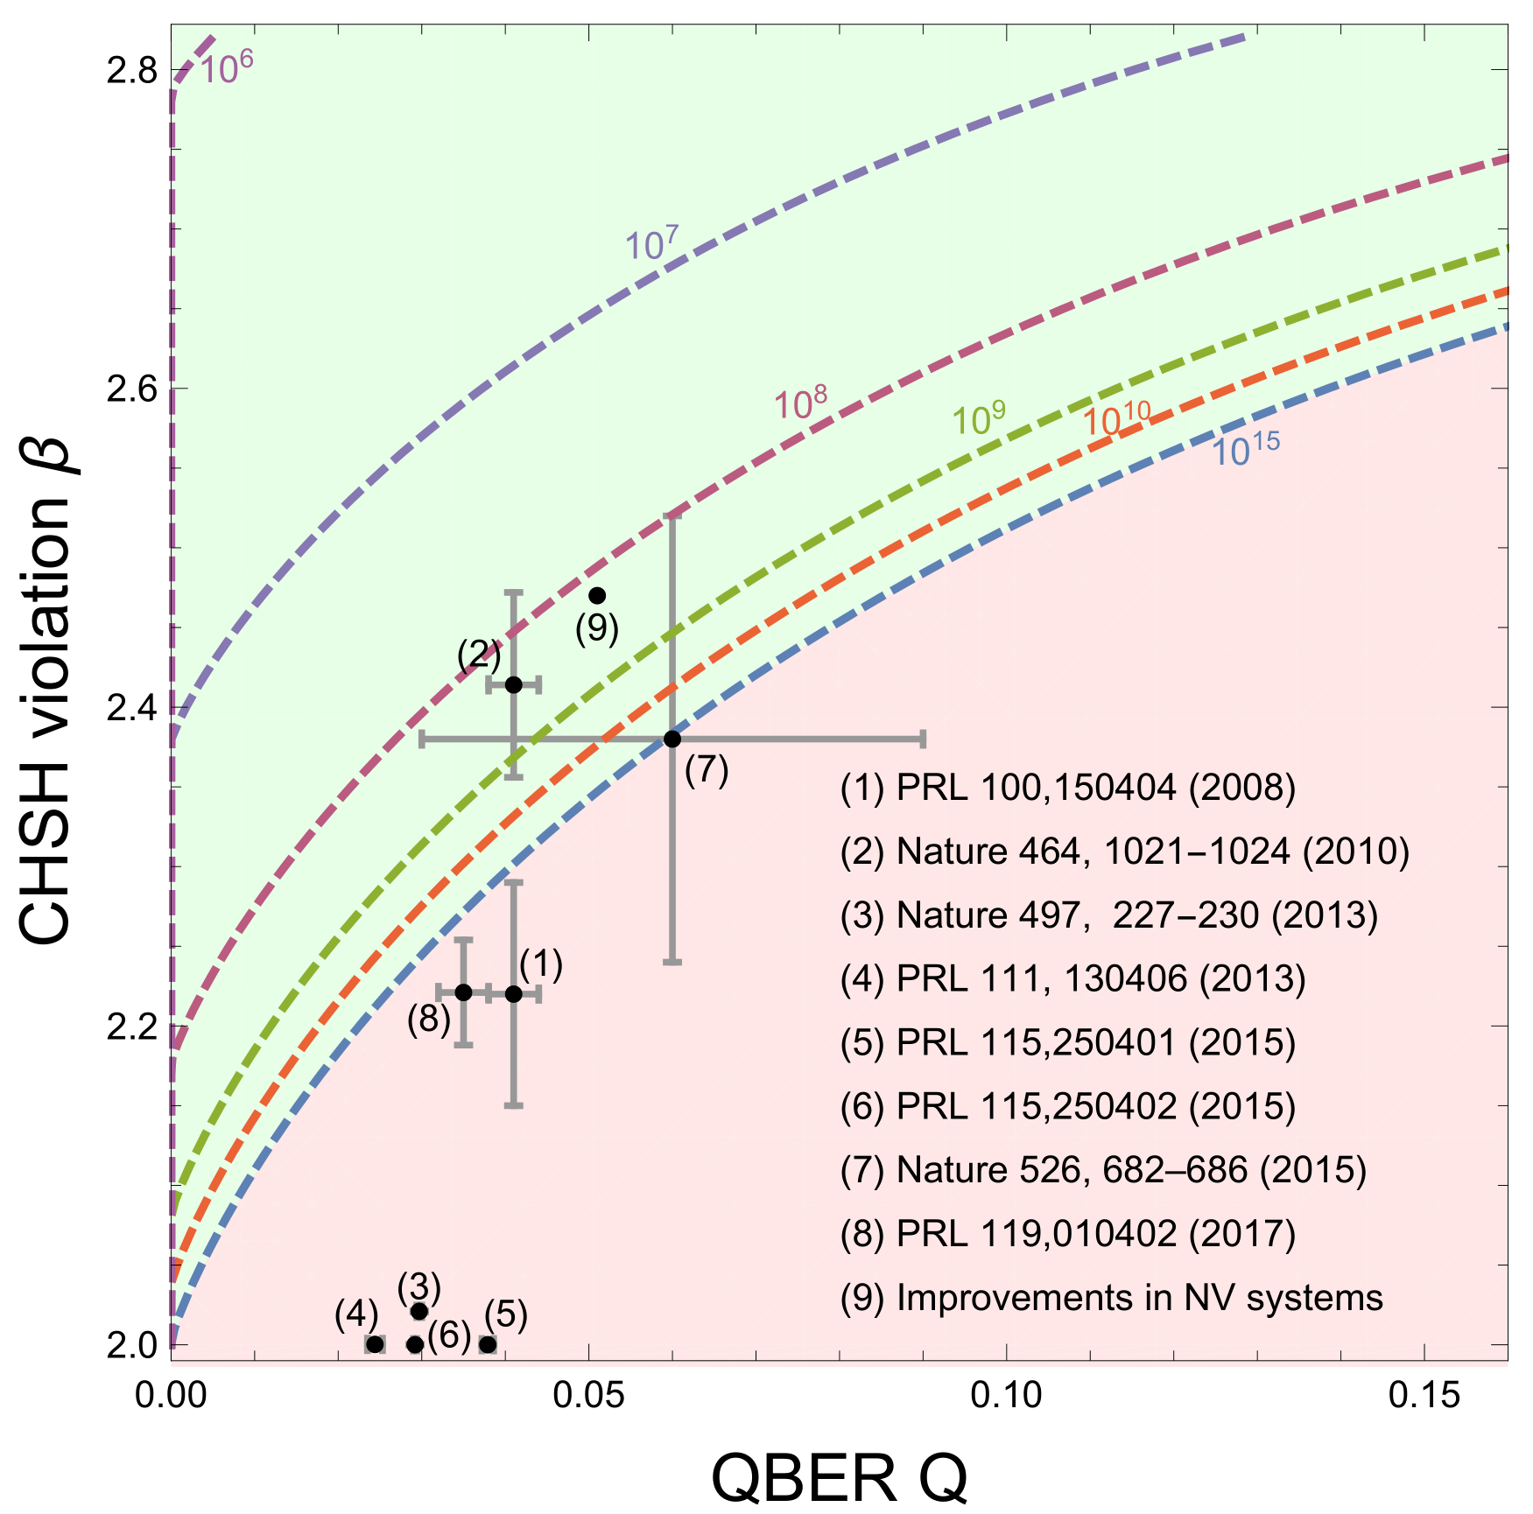
QBER
CHSH
Loophole-free
CHSH
QBER
Our results
[MDR+19] arXiv:1811.07983

Slide 14
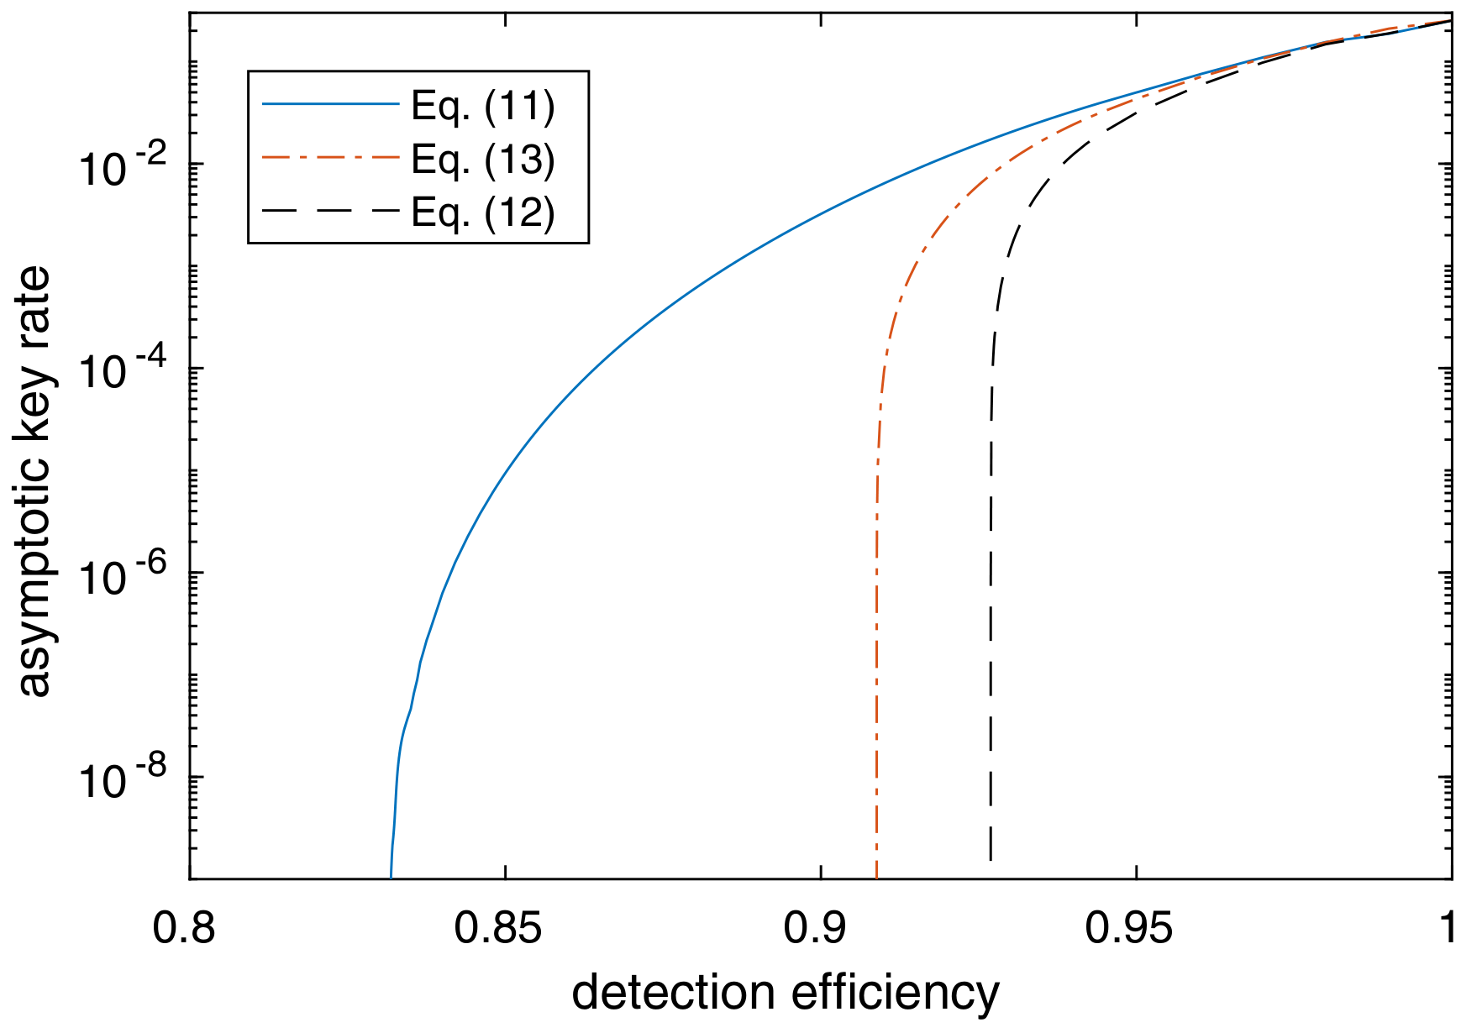
Related results: noisy preprocessing
New results
[ML12]
[PAB+09]
Threshold efficiency ~83.2%
[HST+20] arxiv:2005.13015

Slide 15
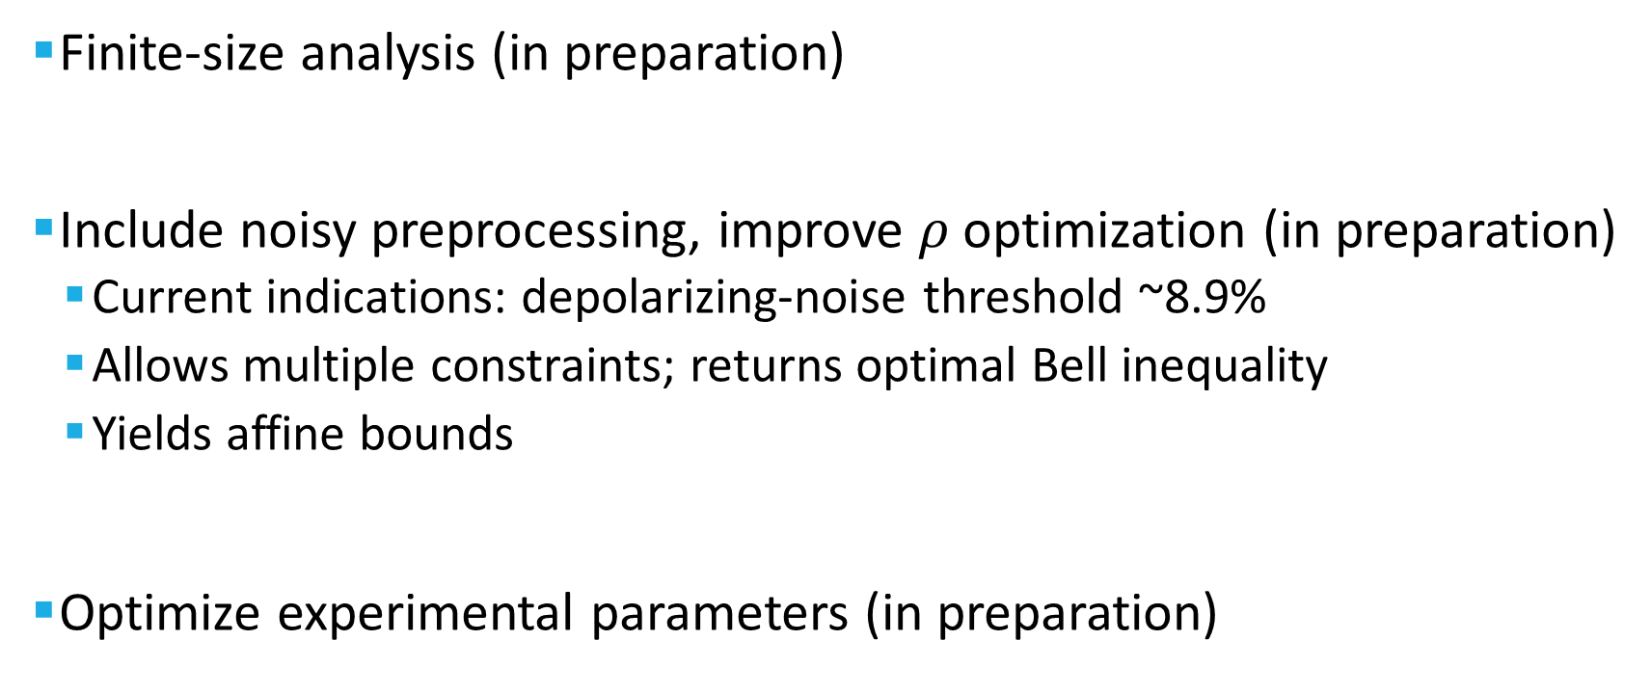
Outlook: crucial questions
Finite-size analysis (in preparation)
Include noisy preprocessing, improve $ρ$optimization (in preparation)
Current indications: depolarizing-noise threshold ~8.9%
Allows multiple constraints; returns optimal Bell inequality
Yields affine bounds
Optimize experimental parameters (in preparation)

Slide 16
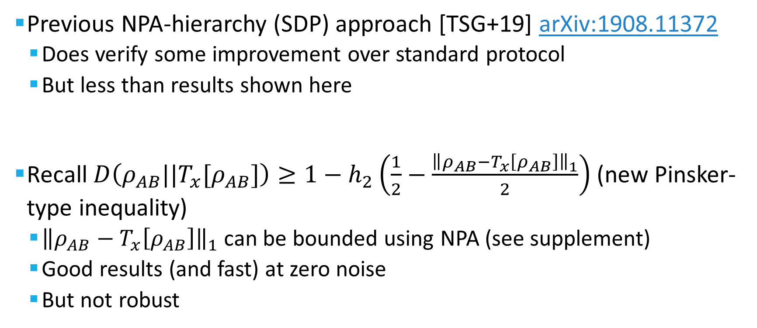
Variant: No qubit reduction?
Previous NPA-hierarchy (SDP) approach [TSG+19] arXiv:1908.11372
Does verify some improvement over standard protocol
But less than results shown here
Recall $D\left(ρ_{AB}||T_{x}[ρ_{AB}]\right)≥1−h_{2}\left(\frac{1}{2}−\frac{{\left\|ρ_{AB}−T_{x}\left[ρ_{AB}\right]\right\|}_{1}}{2}\right)$ (new Pinsker-type inequality)
${\left\|ρ_{AB}−T_{x}\left[ρ_{AB}\right]\right\|}_{1}$ can be bounded using NPA (see supplement)
Good results (and fast) at zero noise
But not robust

Slide 17
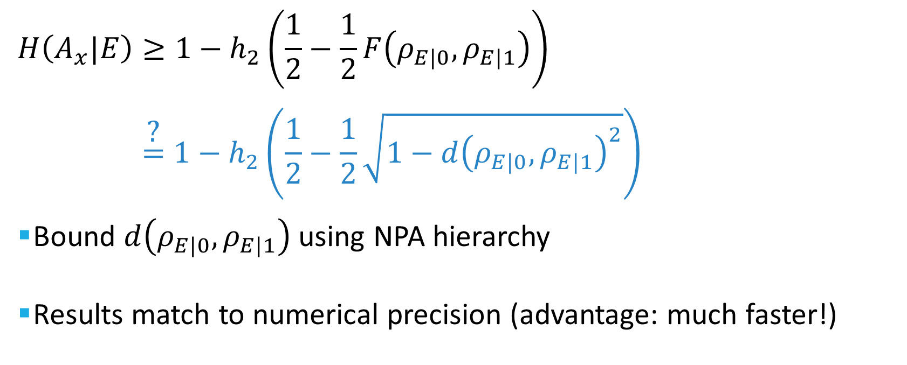
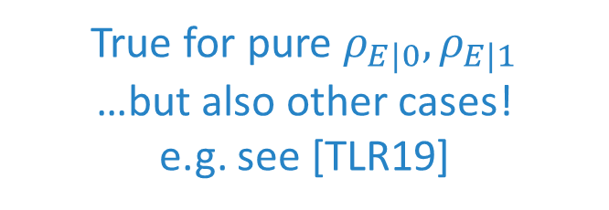
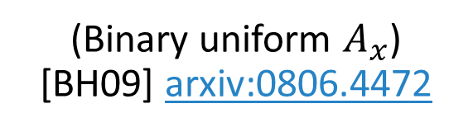
Variant: Conjecture
$$H\left(A_{x}|E\right)≥1−h_{2}\left(\frac{1}{2}−\frac{1}{2}F\left(ρ_{E|0},ρ_{E|1}\right)\right)$$
$$\overset{\text{?}}{=}1−h_{2}\left(\frac{1}{2}−\frac{1}{2}\sqrt{1−{d\left(ρ_{E|0},ρ_{E|1}\right)}^{2}}\right)$$
Bound $d\left(ρ_{E|0},ρ_{E|1}\right)$ using NPA hierarchy
Results match to numerical precision (advantage: much faster!)
(Binary uniform $A_{x}$) [BH09] arxiv:0806.4472
True for pure $ρ_{E|0},ρ_{E|1}$
…but also other cases!
e.g. see [TLR19]

Slide 18
Summary
Substantial improvement to noise tolerance
Going forward:
Finite-size effect (manuscript in preparation)
Improved optimization method (in progress)
Experimental demonstration (in progress)
Related: [BFF20] arxiv:2007.12575, [WAP20] arxiv:2007.16146
Thank you!

